Slide 1
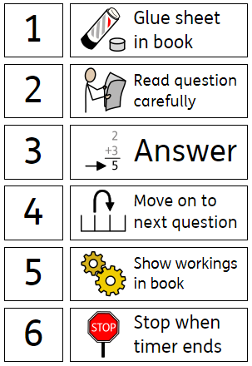
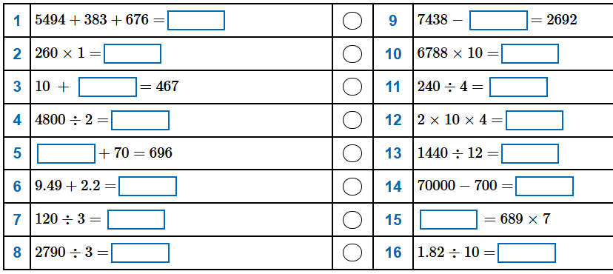
14/11/25 XIV.XI.MMXXV
LO - To solve problems involving adding and subtracting fractions
Set up your book for today, then get ready for 5 minutes of arithmetic as your starter.

Slide 2
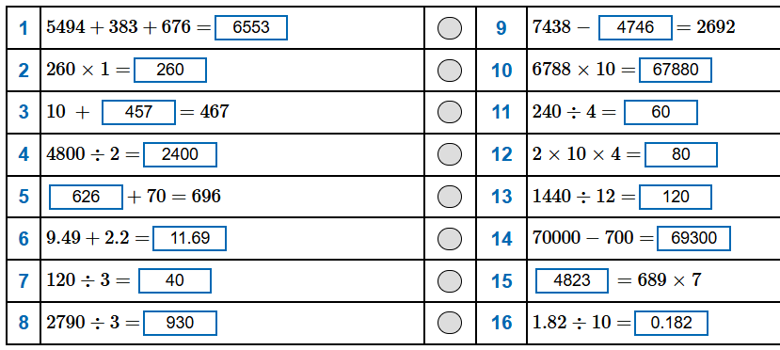

Slide 3
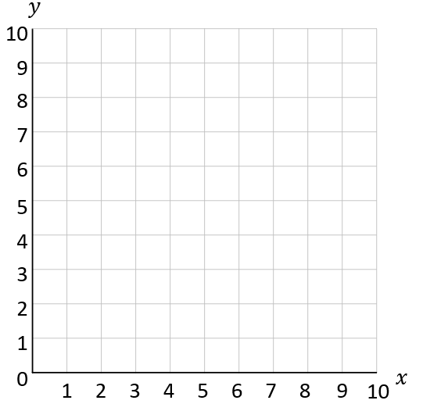
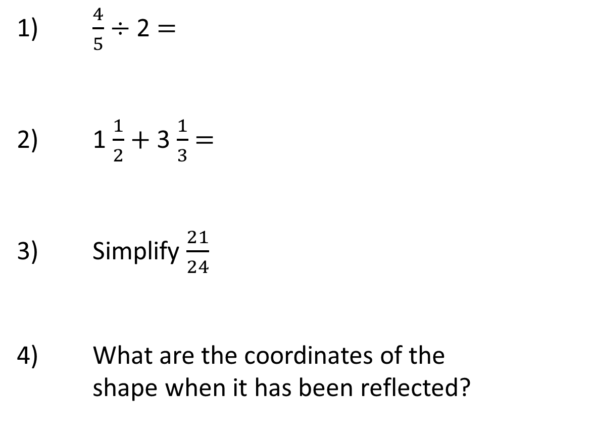
Year 6 | Week 10 | Day 4
CCLXXX
1) $\frac{4}{5}$ $÷$ 2 $=$
2) 1 $\frac{1}{2}$ $+$ 3 $\frac{1}{3}$ $=$
3) Simplify $\frac{21}{24}$
4) What are the coordinates of the
shape when it has been reflected?

Slide 4
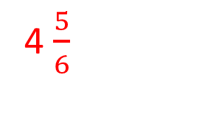

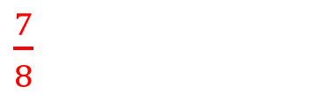
Year 6 | Week 10 | Day 4
CCLXXX
1) $\frac{4}{5}$ $÷$ 2 $=$
2) 1 $\frac{1}{2}$ $+$ 3 $\frac{1}{3}$ $=$
3) Simplify $\frac{21}{24}$
4) What are the coordinates of the
shape when it has been reflected?
$\frac{2}{5}$
280
4 $\frac{5}{6}$
$\frac{7}{8}$
(8, 7) (7, 2) (9, 2)

Slide 5

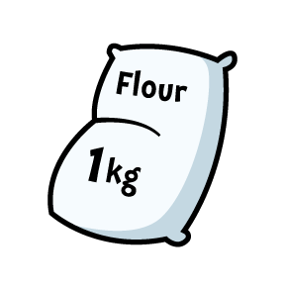
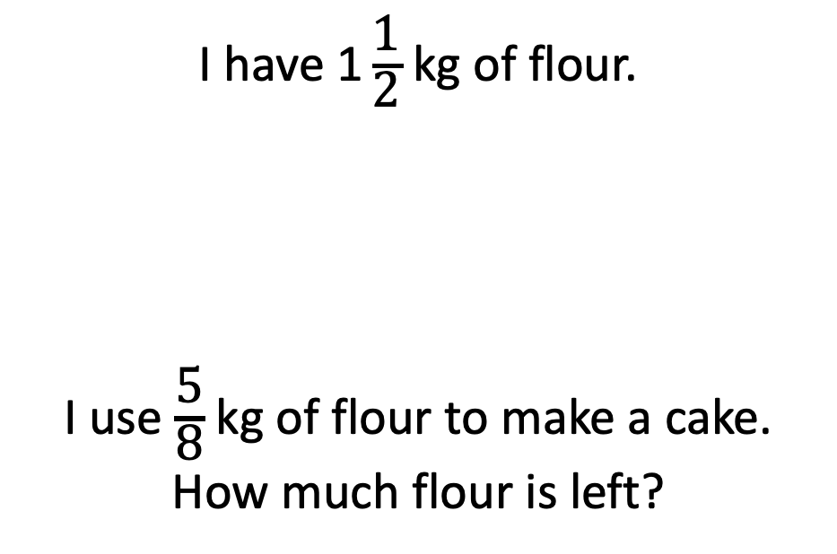
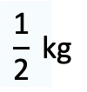
Have a think
I have $\text{1}\frac{\text{1}}{\text{2}}$ kg of flour.
I use $\frac{\text{5}}{\text{8}}$ kg of flour to make a cake.
How much flour is left?
$$\frac{\text{1}}{\text{2}} \text{kg}$$

Slide 6
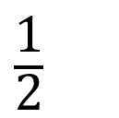
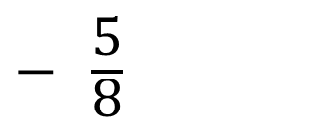
1
$\frac{\text{1}}{\text{2}}$
$− \frac{\text{5}}{\text{8}}$
How much flour is left? Let’s work through this together.
I will record our steps on the board as we go.

Slide 7





Rosie has 1 litre of orange juice.
She gives Eva $\frac{\text{1}}{\text{4}}$ litre and Dexter gets $\frac{\text{2}}{\text{5}}$ litre.
Mo has 1 litre of apple juice.
He gives Jack $\frac{\text{1}}{\text{5}}$ litre and Amir gets $\frac{\text{1}}{\text{2}}$ litre.
Who has the most juice left?
Have a think

Slide 8
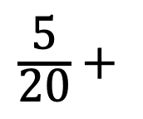
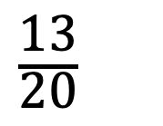

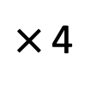
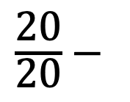
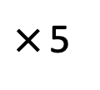

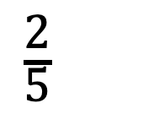
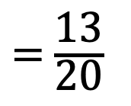
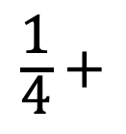
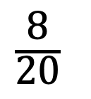
Rosie has 1 litre of orange juice.
She gives Eva $\frac{\text{1}}{\text{4}}$ litre and Dexter gets $\frac{\text{2}}{\text{5}}$ litre.
$\frac{\text{1}}{\text{4}}$ $+$
$\frac{\text{2}}{\text{5}}$
$×$ 5
$×$ 4
$\frac{\text{5}}{\text{20}}$ $+$
$\frac{\text{8}}{\text{20}}$
$=$ $\frac{\text{13}}{\text{20}}$
$\frac{\text{20}}{\text{20}}$ $−$
$\frac{\text{13}}{\text{20}}$
Rosie has $\frac{\text{7}}{\text{20}}$ litre left

Slide 9
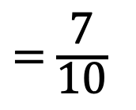
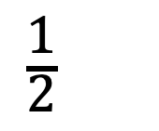
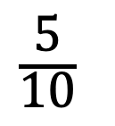
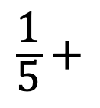
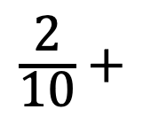
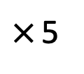

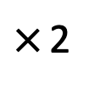

Mo has 1 litre of apple juice.
He gives Jack $\frac{\text{1}}{\text{5}}$ litre and Amir gets $\frac{\text{1}}{\text{2}}$ litre.
$\frac{\text{1}}{\text{5}}$ $+$
$\frac{\text{1}}{\text{2}}$
$×$ 2
$×$ 5
$\frac{\text{2}}{\text{10}}$ $+$
$\frac{\text{5}}{\text{10}}$
$=$ $\frac{\text{7}}{\text{10}}$
Mo has $\frac{\text{3}}{\text{10}}$ litre left

Slide 10



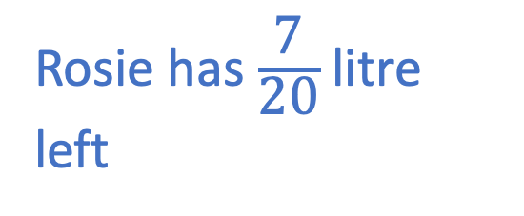

Rosie has 1 litre of orange juice.
She gives Eva $\frac{\text{1}}{\text{4}}$ litre and Dexter gets $\frac{\text{2}}{\text{5}}$ litre.
Mo has 1 litre of apple juice.
He gives Jack $\frac{\text{1}}{\text{5}}$ litre and Amir gets $\frac{\text{1}}{\text{2}}$ litre.
Rosie has $\frac{\text{7}}{\text{20}}$ litre left
Mo has $\frac{\text{3}}{\text{10}}$ litre left
Mo has $\frac{\text{6}}{\text{20}}$ litre left
Who has the most juice left?

Slide 11
Over to you.
Now to work through the sheets in the trays at your pace.
Try to challenge yourself

