Slide 1
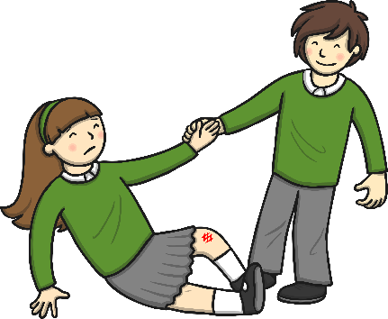
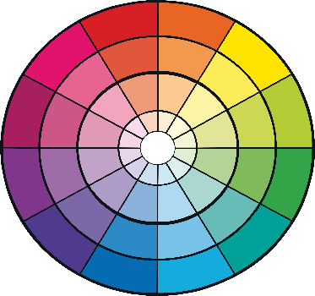



Can you make five new words by adding –ful to the end of the root word shown in each picture? Click the pictures.
help
ful
colour
ful
rest
ful
watch
ful
mouth
ful
Which of these words is not an adjective?
Can you write a sentence using two of the new words?

