Slide 1



Apostrophes for Possession

Slide 2
Aim
I can use apostrophes to show where someone or something belongs.
Success Criteria
I know when I need to use an apostrophe to show possession.
I can use possessive apostrophes correctly.
I can identify possessive apostrophes when I’m reading.

Slide 3

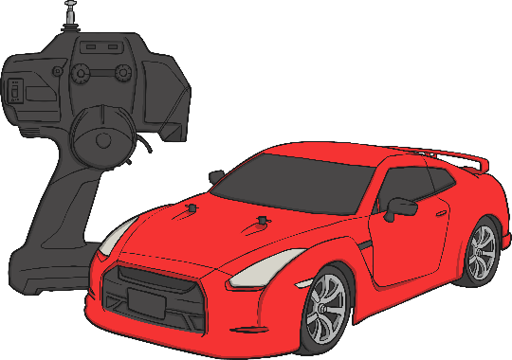

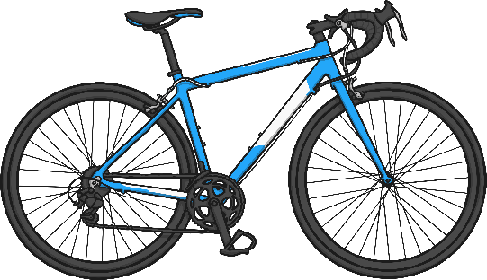
Who Does It Belong To?
When we own or
have something it
is called possession.
Possession
The blue bike
belongs to Isa.
The red car
belongs to Jodie.
The football
belongs to Samera.

Slide 4


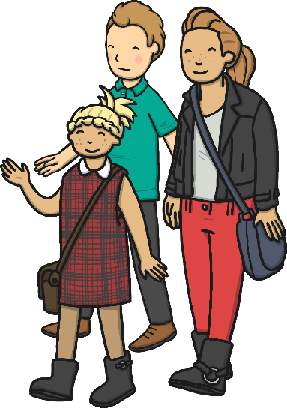
Apostrophes to
Show Possession
These are Maddison’s parents.
What do you notice about this sentence?
Look at the name Maddison.
This sentence contains an apostrophe.
The apostrophe in this sentence tells us that the parents belong to Maddison.
We need the apostrophe to make it clear to our reader who it belongs to.

Slide 5


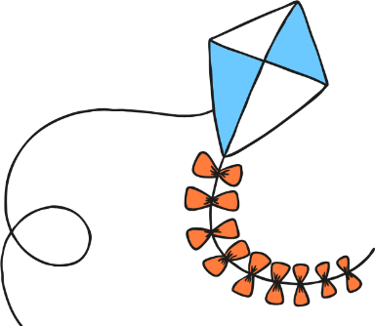
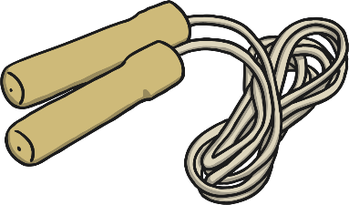

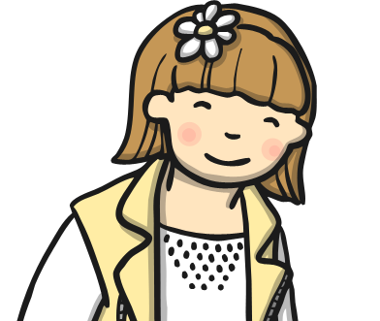
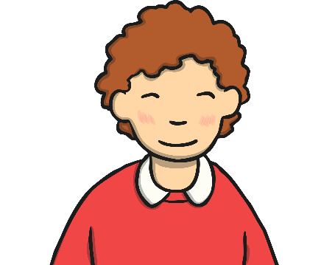


Who Does It Belong To?
My skateboard is very fast.
I love my skipping rope.
This kite is amazing.
This is my favourite book.
Jared
Aqueeb
Sophie
Anna

Slide 6




Apostrophes to
Show Possession
When we say something belongs to someone, we add an ‘s’ to the end of the word. However we also do this when the word becomes plural.
So we add an apostrophe before the ‘s’ to show our reader we mean ‘belongs to’.
one cat
The cat’s bed
two cats
The dog’s bed

Slide 7
Apostrophes to
Show Possession
On your whiteboards, rewrite the sentences below so that they contain an apostrophe. The first one has been done for you.
Remember when we are showing that something belongs to one person, we add the apostrophe before the ‘s’.
Everybody liked the green and yellow bag that belongs to Umar.
Everybody liked Umar’s green and yellow bag.
The cute kitten belongs to Romy.
The toy castle belongs to Zuhara.

