Slide 1
North America
North America
This is the continent of North America.
It is joined to the continent of South America by a narrow strip of land.
South America

Slide 2
North America

Slide 3
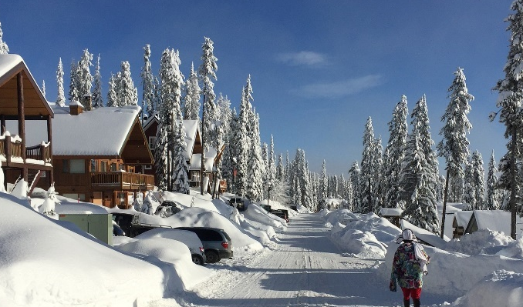
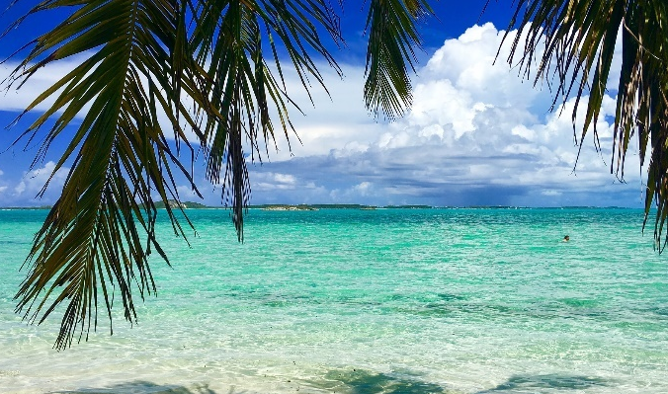
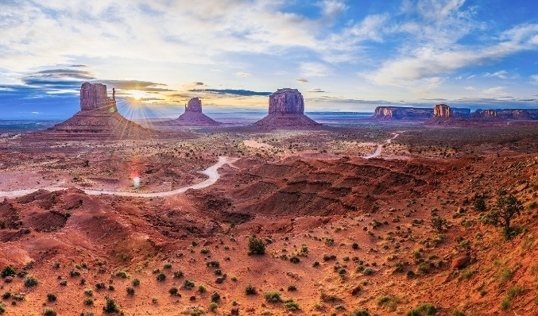
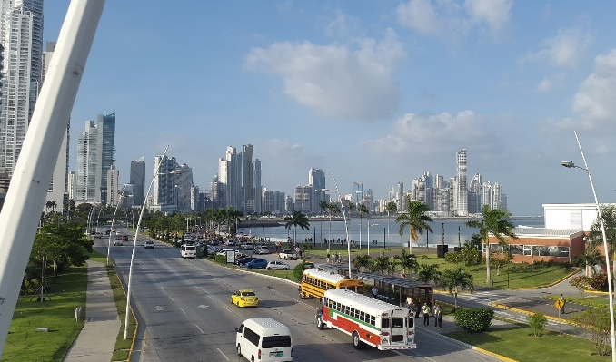
North America
Look at these pictures. Which are images of North America?

Slide 4
North America
Did you work it out? They all are! North America is a huge continent and has a variety of landscapes.
British Columbia, Canada
Bahamas
Panama City, Panama
Monument Valley, USA

Slide 5

USA
America, or United States of America (USA), is split into states. You’ll see 50 stars on the American flag, one for each state. The country’s capital city is Washington DC.

Slide 6
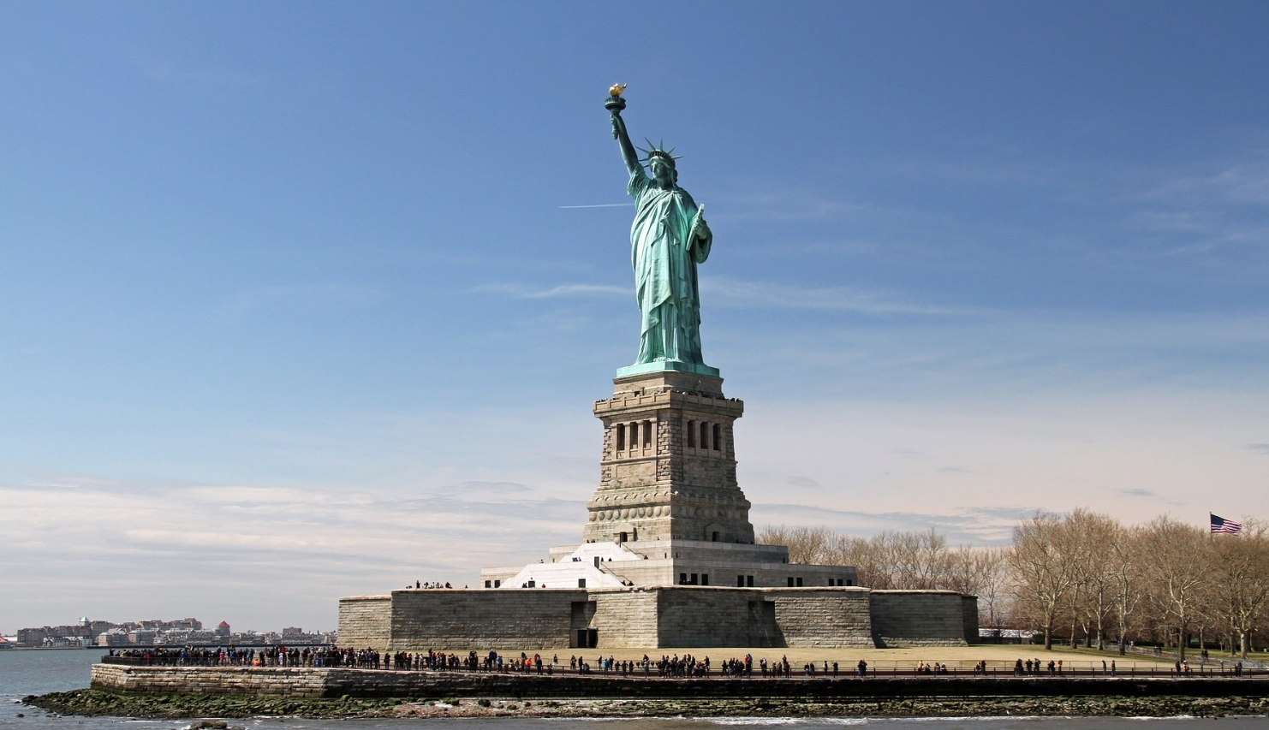
Statue of Liberty
This is the Statue of Liberty in New York, USA. Liberty means ‘freedom’. Listen to Ubercorn’s Funky Facts about the statue that is sometimes called ‘Lady Liberty’!

Slide 7
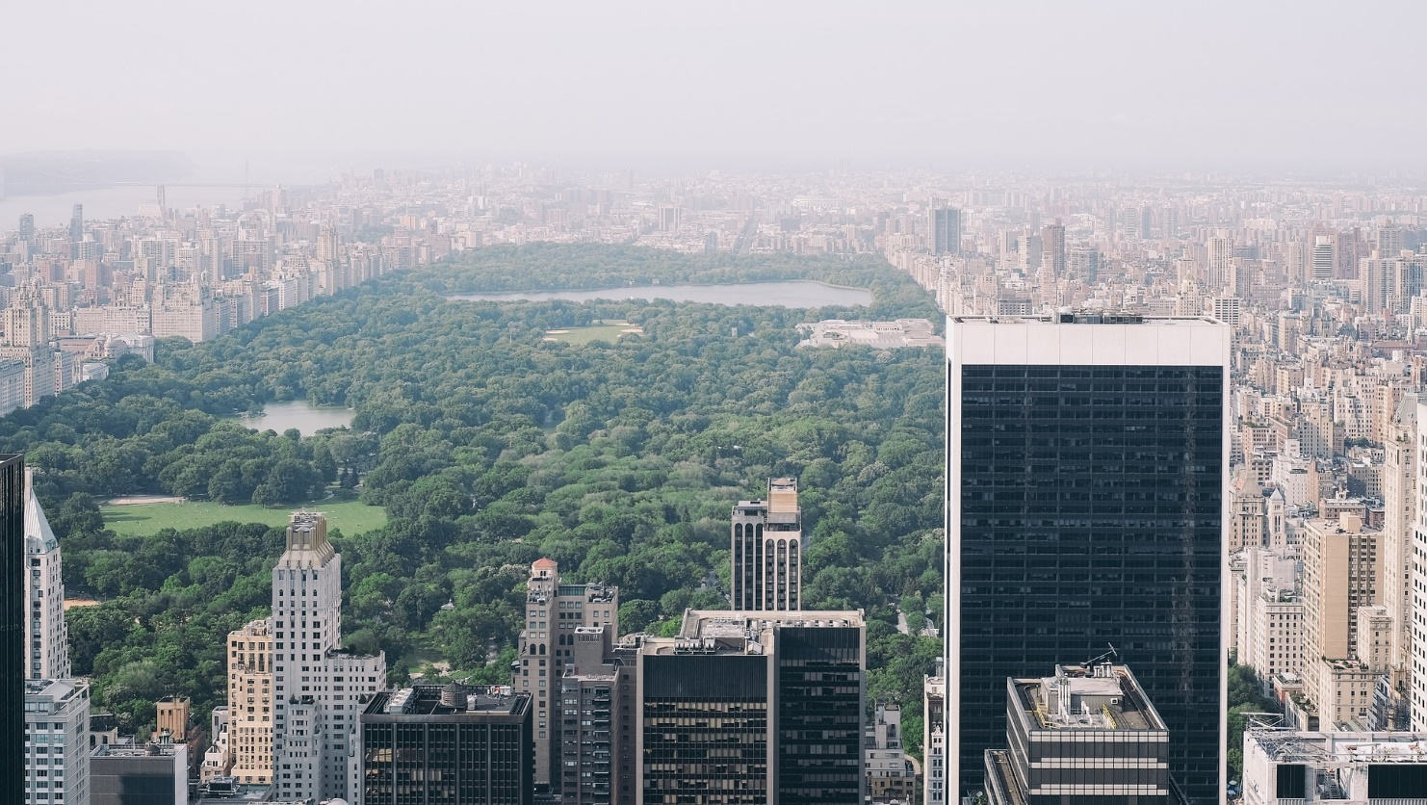
Central Park
Another famous New York landmark is Central Park. Here’s Ubercorn (with a bit of help from Foz and Kyan) to tell us all about it.

Slide 8
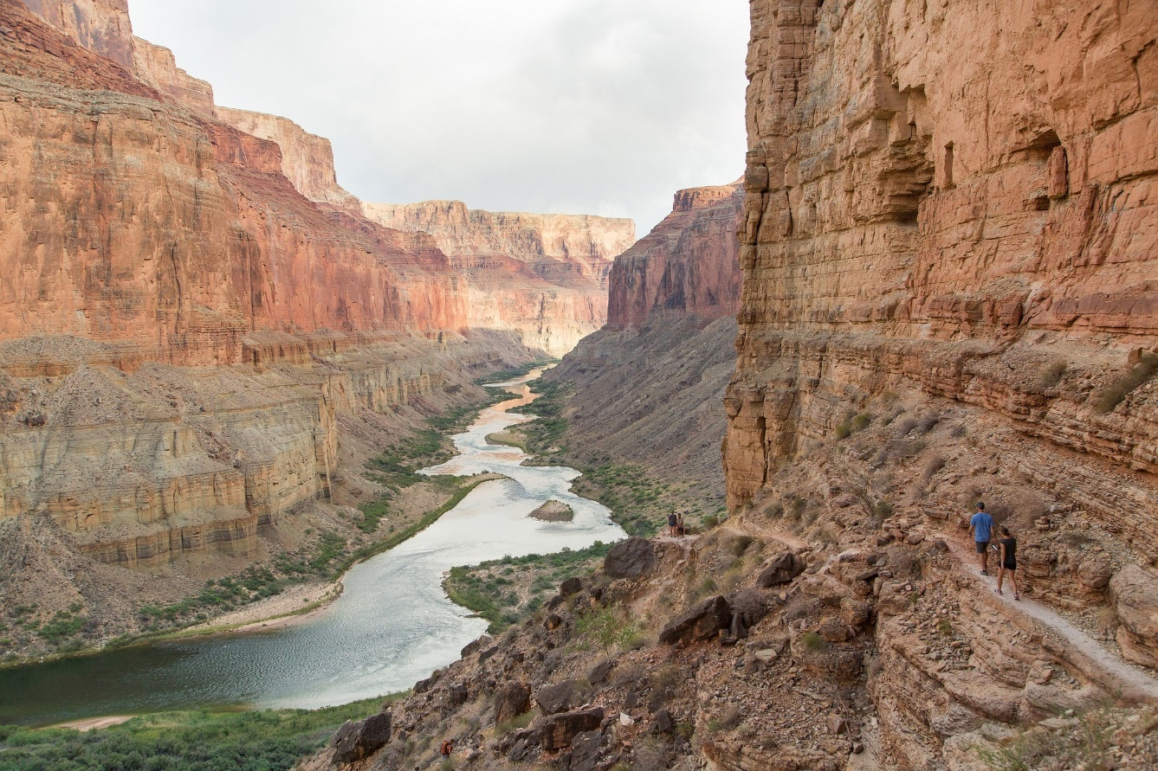
Grand Canyon
Right across the other side of the USA, you’ll find the Grand Canyon in Arizona. Here is Ubercorn with the Funky Facts.

Slide 9
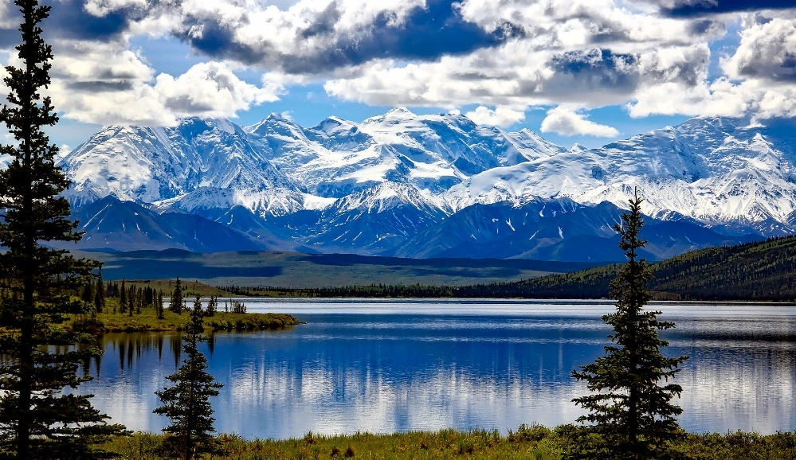
Alaska
Although Alaska isn’t within or next door to USA, it is one of the American states!
This is Denali National Park and Preserve in Alaska.

Slide 10
Canada
Canada is the second largest country in the world! Canada has two official languages: English and French.

Slide 11
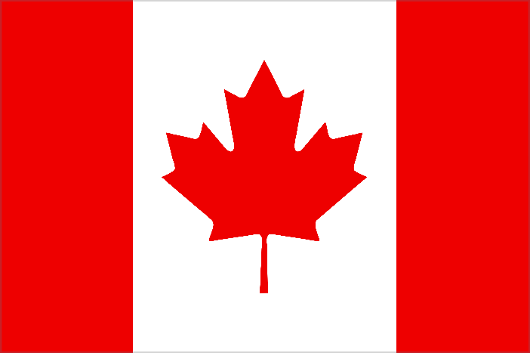
Canada
The maple leaf on Canada’s flag is the
country’s national symbol because it is
a distinctive feature of Canada’s nature.
Toronto is the most populated city in Canada with over 5 million people!

Slide 12
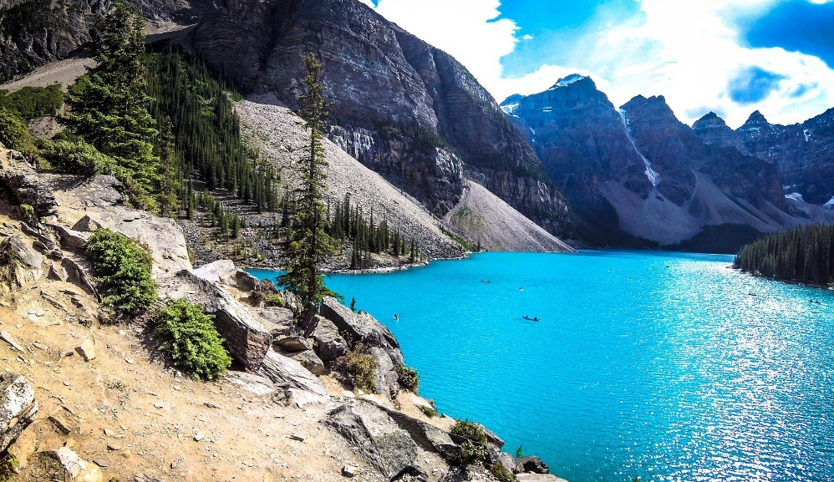
Banff National Park
Moraine Lake
Canada’s oldest national park is in Alberta, in the Rocky Mountains. People come here to visit the beautiful scenery including Moraine Lake, Lake Louise and Mount Norquay.
Tourists enjoy skiing, kayaking, cycling and hiking here.

