Slide 1


Slide 2
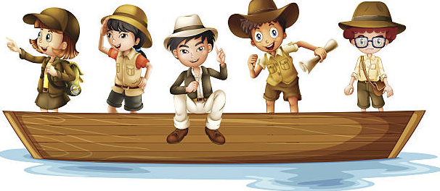
Great Explorers we have discovered so far…

Slide 3
Timeline
1492
Christopher Columbus discovered America
1666
Great Fire of London
1769 Captain Cook discovered Australia and New Zealand
1914 Ernest Shackleton tralled to Antarctica on the Endurance
1969 Neil Armstrong landed on the moon which you learnt about in Year 1
1325 Ibn Battuta began his 30 year travels across the world.

Slide 4

Were there any women explorers?

Slide 5
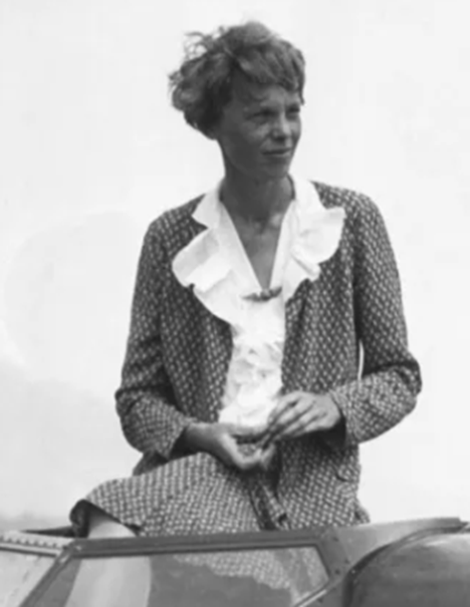
Amelia Earhart – was American and the first woman to fly across the Atlantic in 1928 as a passenger. In 1932 she flew on her own (solo) across the Atlantic and in 1935 she flew solo across the Pacific.

Slide 6
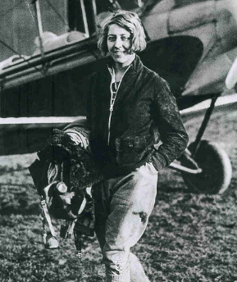
Amy Johnson – was British and in 1930 she was the first woman to fly solo from England to Australia. It took her 19 days.

Slide 7
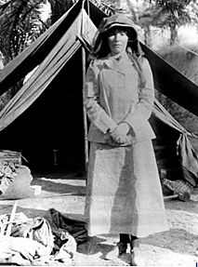
Gertrude Bell was a famous English traveller in the Middle East and Arabia in the years before World War I (1914). Drawing up lots of maps of the deserts and surrounding countries.

Slide 8
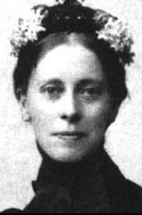
Mary Kingsley – English woman who explored African.

Slide 9
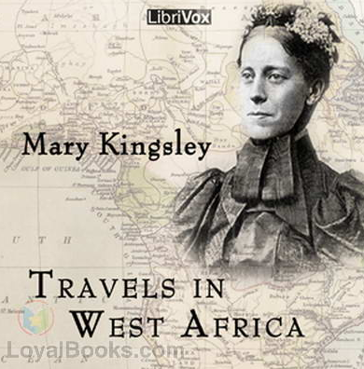
Mary Kingsley was born in 1862.
Her parents let her brother go to school but she wasn’t allowed to go as they wanted her to stay at home to look after her mother who was ill.
Her father was a doctor who travelled around the world on adventures.
While she was at home she liked to spend her time in her father’s library reading all about the places that he went on his adventures.
In 1892 both her parents died so she went to the Canary Islands to recover from her loss.
Whilst there she developed a love for travelling and decided to do more.

Slide 10
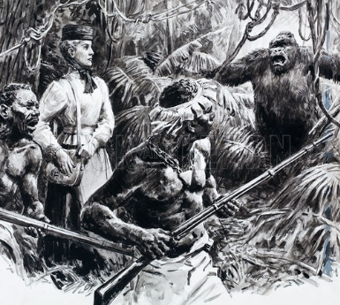
In August 1893 she travelled to Angola in West Africa.
Despite the hot climate, she wore the skirts, blouses, high buttoned shoes and hats she wore at home.
She collected new fish and plants only found in Africa.
She rowed a canoe up the Ogowe River in Gabon.
She was the first woman to climb Mount Cameroon, with a summit of 4175 meters.

Slide 11
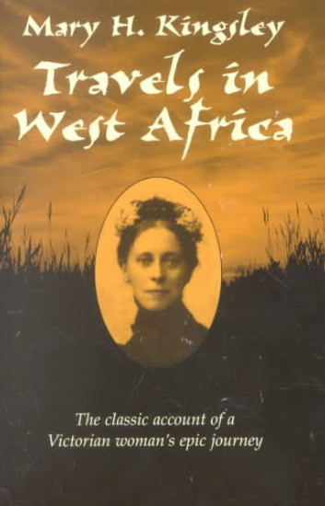
In 1895 she travelled back to England living with her brother.
She wrote a book “Travels in West Africa”. This book is still published today.
She returned to Africa in 1899, this time she also went to South Africa and spent time in Cape Town.
The Boar War was ongoing at this time so she became a nurse looking after the wounded soldiers.
She became ill looking after the soldiers and died in 1900.

