Slide 1
Making a plan

Slide 2
Aims
I can understand what a plan is
I can understand what aerial view means
I can look at aerial photos and identify three features
I can name three features on my plan
I can draw a plan

Slide 3

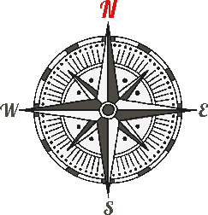
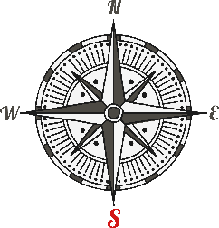


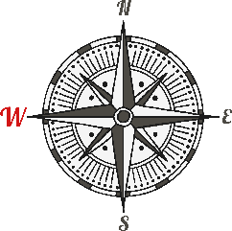

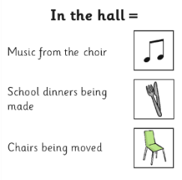

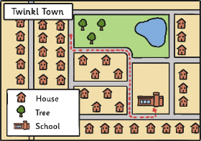
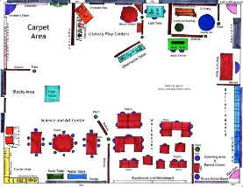
Key Words
compass
directions
north
south
aerial view
(birds eye view)
east
west
key
title
plan
observation
Photo courtesy of Barrett.Discovery @flickr.com) - granted under creative commons licence – attribution

Slide 4

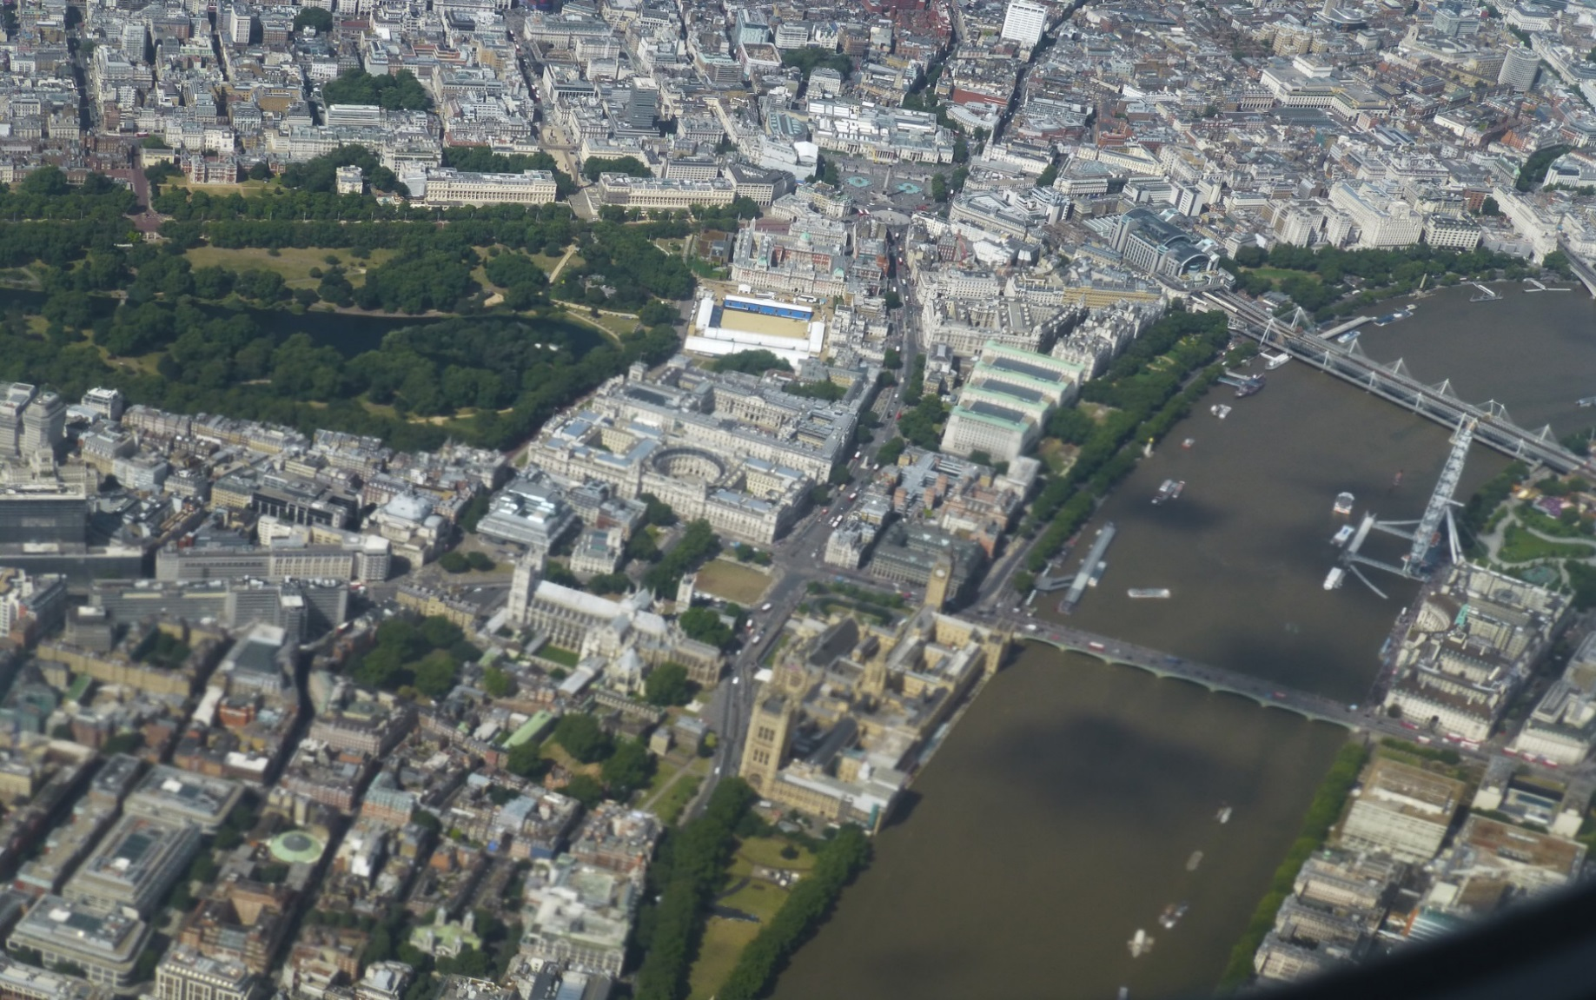
What Is a ‘Birds Eye View’?
Photo courtesy of givingnot@rocketmail.com (@flickr.com)-granted under creative commons license-attribution
Notes:
Note for teacher: Add name of area.

Slide 5
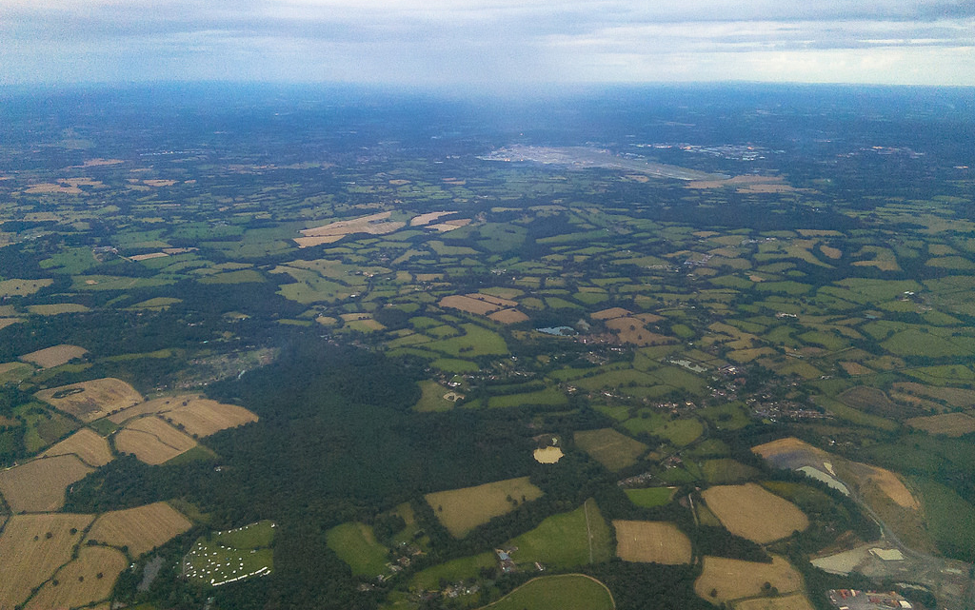
What Is an Aerial View?
Photo courtesy of Gemma Thomson (@flickr.com)-granted under creative commons licence - attribution
Notes:
Note for teacher: Add name of area.

Slide 6



Spot the Difference!
Photo courtesy of sarfraz hayat and givingnot@rocketmail.com (@flickr.com)-granted under creative commons licence - attribution
Notes:
Note for teacher: Add name of area.

Slide 7
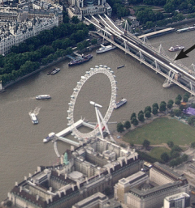

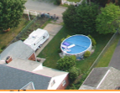
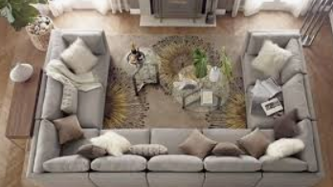
Can you identify what these aerial view features are?

Slide 8


What Is an Aerial Plan?
Photo courtesy of CJ(@flickr.com)-granted under creative commons license-attribution
Notes:
Note for teacher: Add name of area.

Slide 9
Now it is your turn to draw a plan of your garden or a room in your house.

