Slide 1

The Runaway Chapati
Created by Danielle Noone

Slide 2
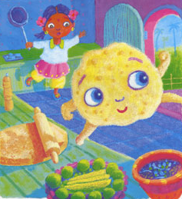

Once, a little girl made a chapati to fry for her tea.
Yum Yum! This chapati looks delicious.
But the chapati didn’t want to be eaten. Up from the table it jumped and out of the door it ran.

Slide 3
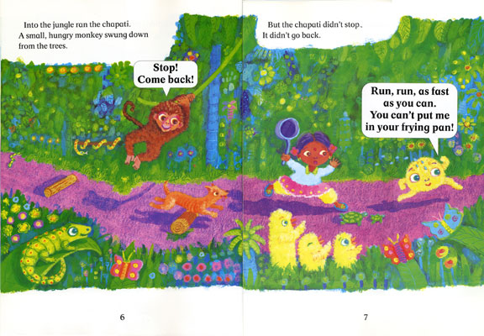
The chapati ran away singing…

Slide 4
Up the road ran the chapati.
Woof Woof!
What a round delicious chapati. I want to eat you.
A hungry dog smelt it.
The chapati didn’t stop, it didn’t go back. The chapati ran away singing…

Slide 5
Into the jungle ran the chapati. A small hungry monkey swung down from the trees.
The chapati didn’t stop, it didn’t go back. The chapati ran away singing…
Ooo Ooo Aaa Aaa!
What a round delicious chapati. I want to eat you.

Slide 6
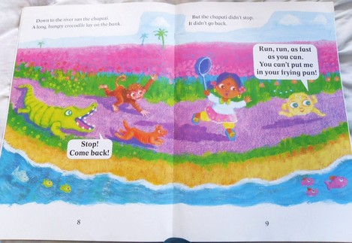
Down to the river ran the chapati. A long hungry crocodile lay on the bank.
The chapati didn’t stop, it didn’t go back. The chapati ran away singing…
What a round tasty chapati. I want to eat you.

Slide 7
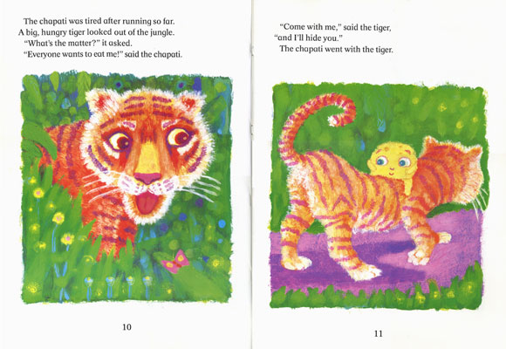
The chapati was tired after running so far.
A big, hungry tiger looked out of the jungle.
“What’s the matter?” it asked.
“Everyone wants to eat me!” said the chapati.

Slide 8
“Come with me” said the tiger,
“and I’ll hide you.”
The chapatti went with the tiger.

Slide 9
The girl, the dog, the monkey and the crocodile ran up shouting “Stop! Come back!”
They looked up, they looked down, they looked
round and round, but they couldn’t see the chapati.

Slide 10
“Where is the chapati?” the girl wondered.
Where is the chapati?
Just then the tiger came out of the jungle licking its lips.
“The chapati has gone where you will never find it” said the tiger.
“Where has it gone?” asked the girl.
“Come with me and I’ll show you” said the tiger.
Mmm…

Slide 11
“Nooo!!!” they screamed.
Away they all ran. No one wanted to go where the chapati had gone.
Nooo!!!
Nooo!!!
Nooo!!!
Nooo!!!

Slide 12
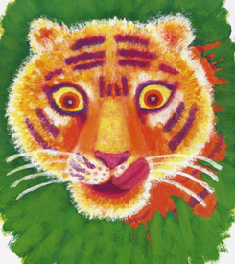
Would you?

