Slide 2
Asia
Planet Earth is made up of seven continents.
One of these continents is called Asia.
Asia is made up of 48 countries, including China, India, Thailand, Vietnam and Malaysia.
Asia is the home to many different animals. We are going to learn about some now…

Slide 3
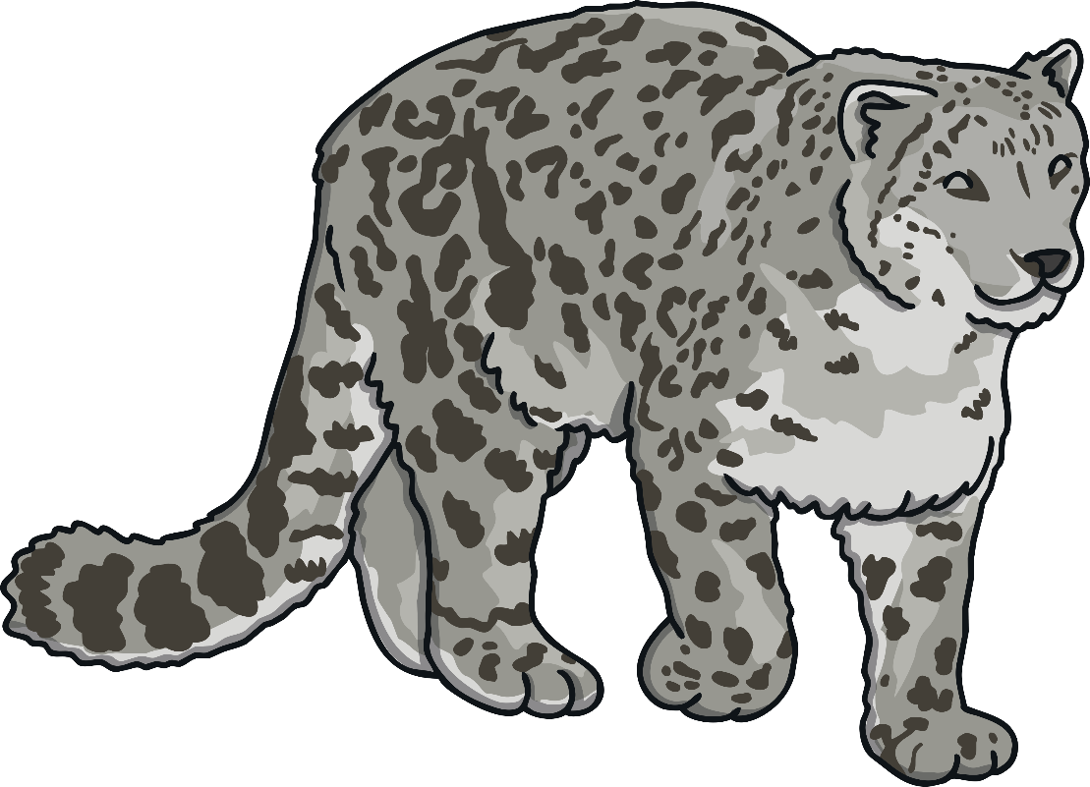
Snow Leopard
The snow leopard is a type of leopard.
Appearance: Snow leopards have white-grey fur with large black rosettes.
Habitat: Snow leopards live in the steep
and rocky mountains of Central Asia.
They are also found in 12 countries,
including China, Bhutan, Nepal, India,
Pakistan, Afghanistan, Russia
and Mongolia.
Diet: Snow leopards eat sheep,
marmots and hares.

Slide 4

Snow Leopard
Snow leopards have very long tails which help them to balance when climbing. Their tails also keep them warm when they sit down and wrap them around their bodies.
Snow leopards are listed as vulnerable on the International Union for Conservation of Nature (IUCN)’s Red List.
Did You Know…?
Snow leopards are strong and can leap forwards six times the length of their bodies.

Slide 5
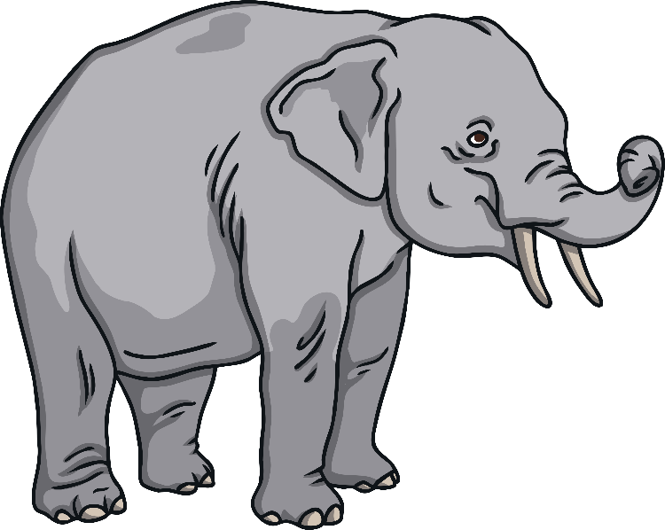
Asian Elephant
Asian elephants are the biggest land mammals on the continent of Asia.
Appearance: Asian elephants have large bodies and
a long trunk. Only male Asian elephants grow tusks.
Habitat: Asian elephants live in different
climates. They can live in dry or wet forest and
grasslands. Asian elephants live in 13 countries
across South and Southeast Asia.
Diet: Asian elephants eat plants and can spend up to 18
hours a day eating. They eat tree bark, roots, leaves and fruit.
Did You Know…?
Asian elephants use their trunks to do lots of different things, such as picking up objects, greeting other elephants, trumpeting a warning sound and sucking up water for drinking or bathing.

Slide 6
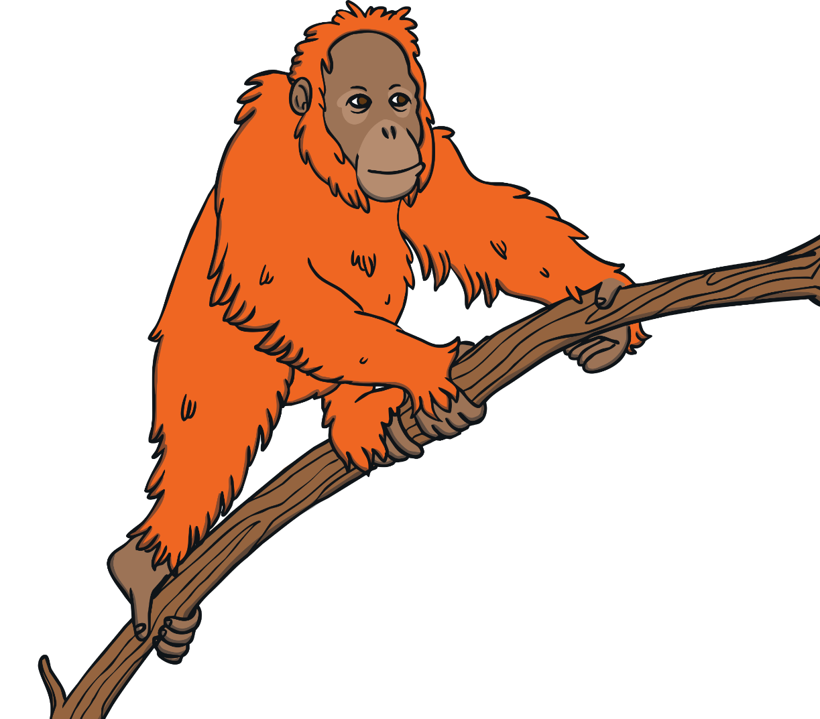
Orangutan
Orangutans are the world's largest arboreal mammals. Arboreal means that they eat, sleep and play in trees.
Appearance: Orangutans have reddish fur and
long powerful arms.
Habitat: Orangutans live in lowland forests
in Asia. Orangutans like to be on their own
and have their own space. Orangutans
spend most of their time in trees and they
make nests in trees to sleep in at night.
Diet: Orangutans eat wild fruits,
such as lychees, mangosteens, and
figs and drink water from holes in trees.

Slide 7

Orangutan
Orangutans are listed as critically endangered on the International Union for Conservation of Nature (IUCN)’s Red List.
Did You Know…?
The name orangutan means "man of the forest" in the Malay language.
Orangutans have feet and hands that can grasp, like human hands, which helps them to move through branches.

Slide 8
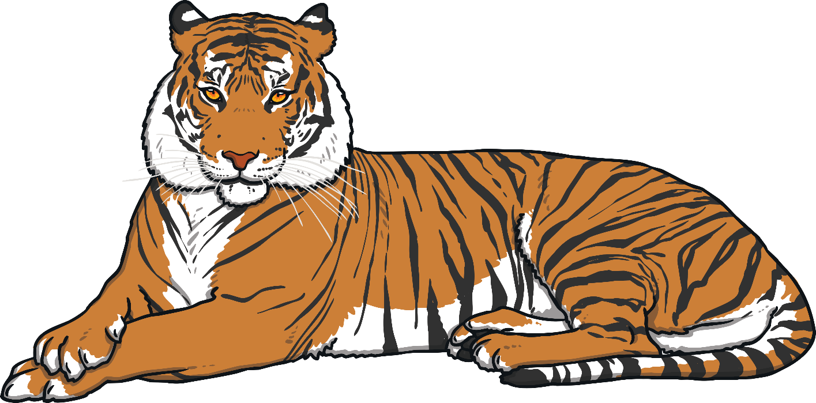
Tiger
Appearance: Tigers have orange fur coats with black vertical stripes. They have a lighter underside.
Habitat: Tigers are found all over Asia and live in India, Nepal, Bhutan, Russia, Myanmar, Malaysia, Sumatra and China. They live in tropical rainforests, evergreen forests, temperate forests, mangrove swamps, grasslands, and savannahs.
Diet: Tigers hunt for food and eat
deer and wild boar.

Slide 9
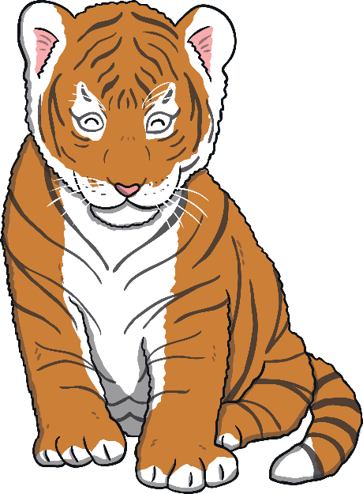
Tiger
Tigers are listed as endangered on The International Union for Conservation of Nature (IUCN)’s Red List.
Did You Know…?
Tigers have been known to reach up to 20 years of age in the wild.
Tiger usually hunt alone and mainly use their senses of sight and sound to help them find their prey.

Slide 10
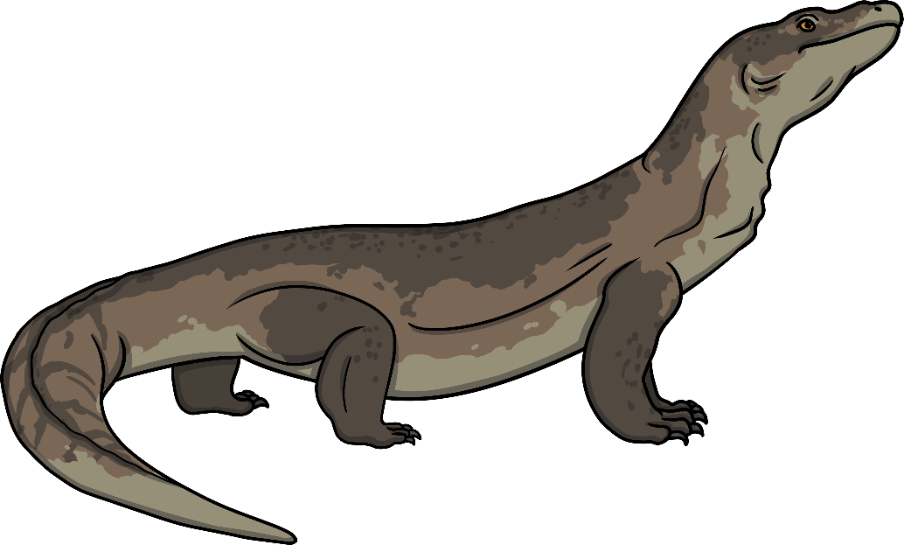
Komodo Dragon
Komodo dragons are the heaviest lizards on Earth.
Appearance: Komodo dragons have flat, long heads with rounded snouts, scaly skin, bowed legs, and large, muscular tails.
Habitat: Komodo dragons have lived in Indonesia for millions of years. They are found on the Komodo island and some of the other
Lesser Sunda Islands.
These islands have hot temperatures
and are mainly dry forests with
patches of rainforests.

Slide 11
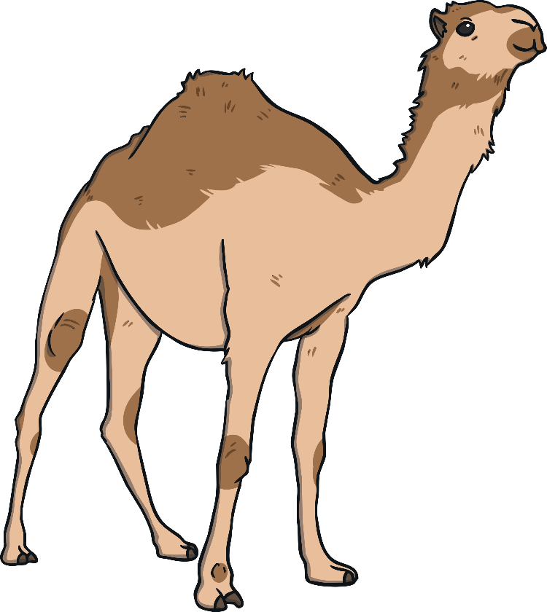
Camel
Camels are hoofed mammals that are known for being able to go for a long time without drinking.
Appearance: Camels have 4 legs, a long neck and are
covered in light brown or greyish coloured camel
hair. Camels have one or two humps on their backs.
Habitat: Camels live in deserts and are used to very
hot and dry weather in the day and very cold
temperatures at night.
Diet: Camels will eat anything they can find and often eat
dried leaves, seeds and thorny twigs. When there is a lot of
food, camels will over eat and store fat in their humps. In very
hot conditions, a camel can live for four to seven days without
drinking. Camels can last for six months without drinking at
all if they are resting and their food contains enough water.

Slide 12
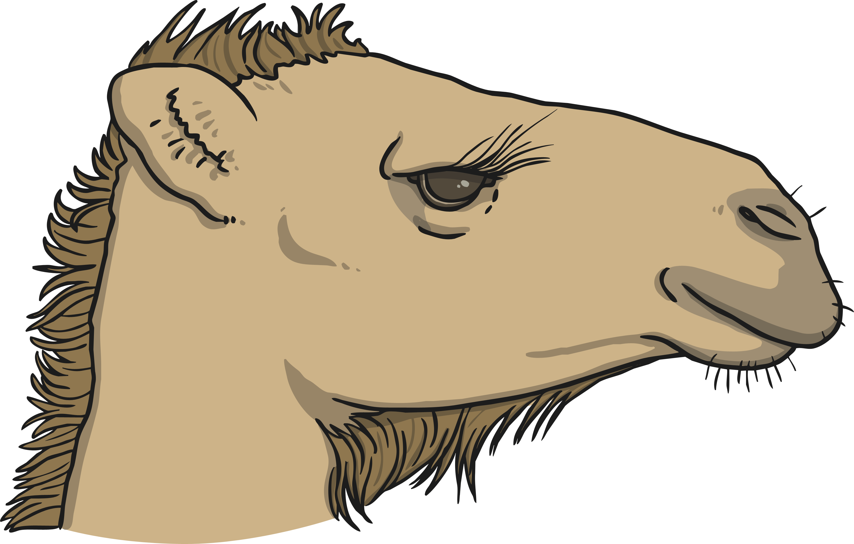
Camel
Did You Know…?
Camels have heavy eyelashes to protect their eyes from blowing sand and they can squeeze their nostrils shut. A camel’s top lip is split into two sections that move independently. Camels don’t walk on their hoofs. Instead, they put their weight on to two large toes which spread apart to stop camels sinking into the sand.

Slide 13
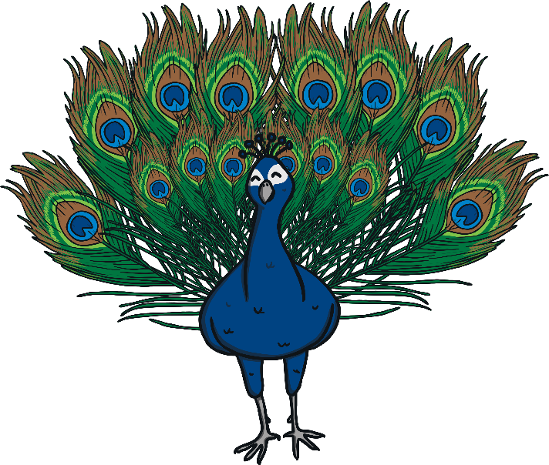
Peacock
Peacocks are large birds that are known for their colourful tails.
Appearance: Peacocks are male birds (females are
called peahens and look different). Peacocks are
usually blue and green and have long tail feathers
that make up more than half of a peacock’s length.
Habitat: Peacocks live in warm and wet climates,
but can survive cold winters.
Diet: Peacocks eat insects, plants, and small creatures.
Did You Know…?
Peacocks spread out their tail feathers into a fan shape in order to show off their feathers to peahens. Each tail feather
is very colourful and has blue, gold and red and a marking that looks like an eye.

