Slide 2

Text Features
Text features are included in nonfiction text to help the reader better understand the material.
There are many different types of text features that provide unique information to the reader, that can…
Tell or explain new information
Help the reader find information

Slide 3

Headings and Subheadings
A heading is included at the top of the text, to tell the reader what the entire text is about.
A subheading tells the reader what information they will find in the following paragraphs before the next subheading.

Slide 4
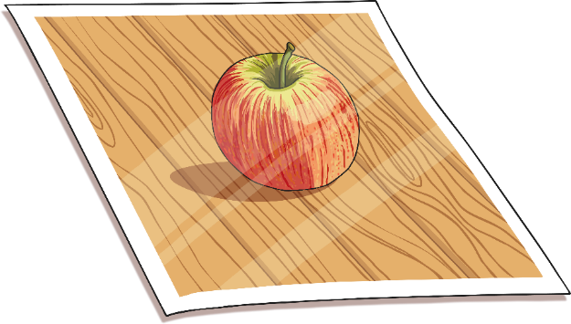
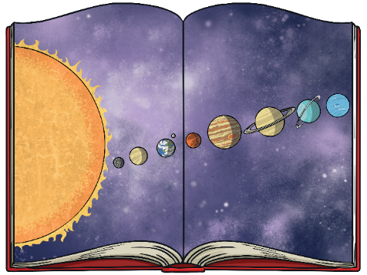
Photographs and Illustrations
Authors often choose to include photographs or illustrations to help the reader better understand the information.
A photograph may be an actual picture from an event in history or of a unique underwater creature.
An illustration may be a diagram that explains a complex body system or scientific process.

Slide 5
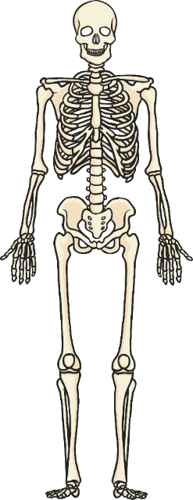
Captions and Labels
A caption briefly explains what a photograph or illustration is about. It is often a short phrase or sentence that is located directly next to or under the image.
A label points to a specific part of a photograph, illustration, or diagram, and tells you the name of that part.
skull
ribs
pelvis
femur
Skeletal system of a human

Slide 6

Bold Words
Throughout the text, an author may choose to make a word bold.
A bold word is often an important word to the subject of the text or a difficult word that the reader may not know.
If you see a bold word, there is a good chance you can find the definition in the glossary.

Slide 7
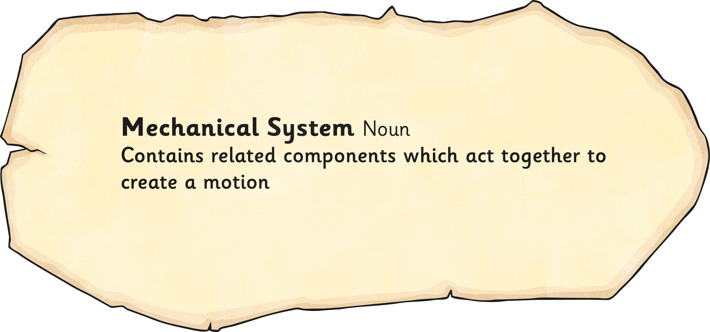
Glossary
A glossary is included at the end of a book.
Bold words throughout the text are listed in alphabetical order.
Next to each word is a definition of the word to help the reader better understand the information.

