Slide 1
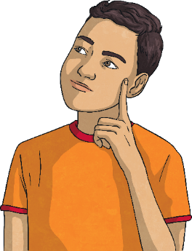
Telling the Time
When we are telling the time, it is really important to be able to
count in 5s.
Can you count in 5s from 0 to 60?
0
5
10
15
20
25
30
35
40
45
50
55
60

Slide 2
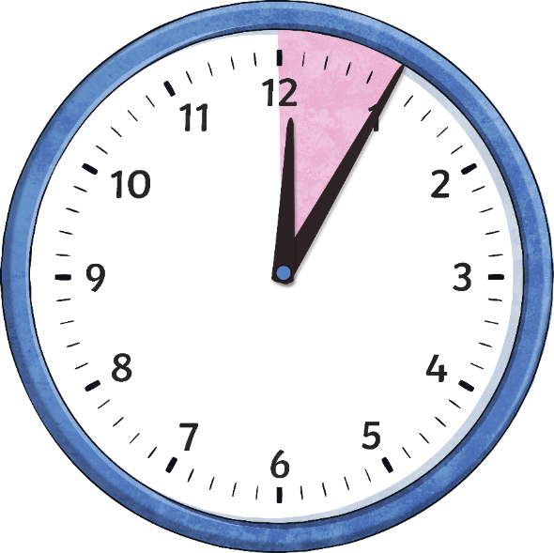
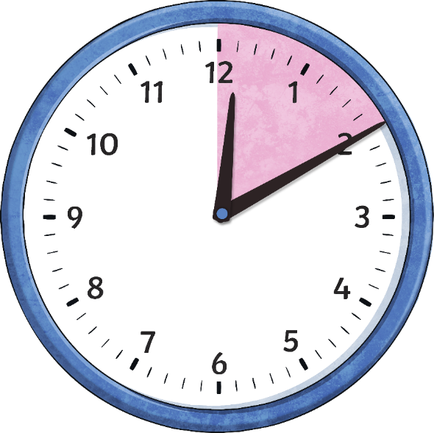
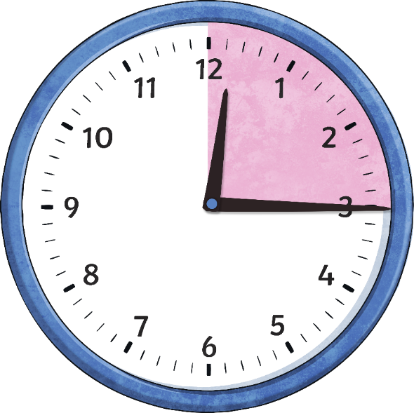
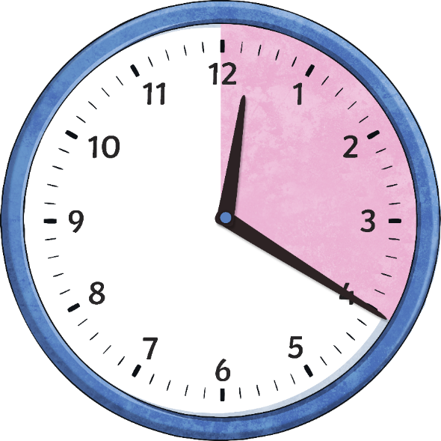
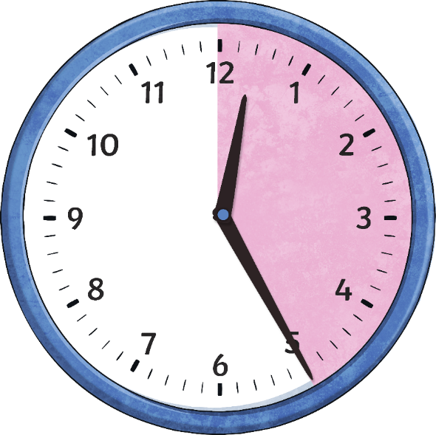
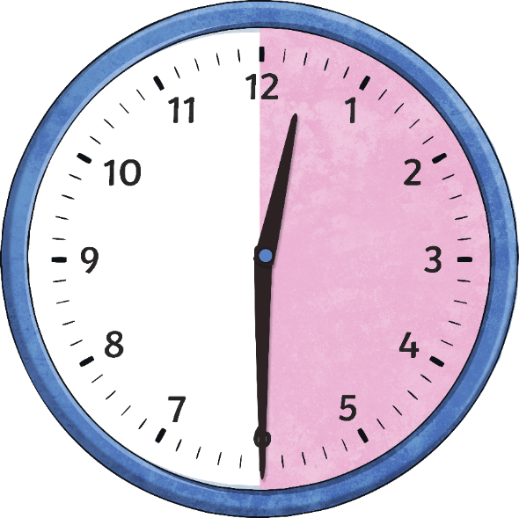
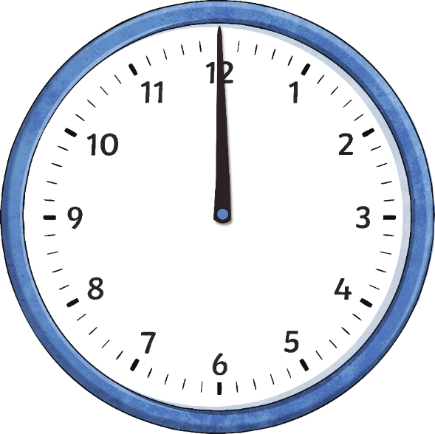
Telling the Time
The big hand on the clock counts the minutes and is called
the minute hand.
We are going to look now at the minutes past the hour.
20
25
30
5
10
15
minutes
past
minutes
past
minutes
past
minutes
past
minutes
past
minutes
past
o’clock

Slide 3
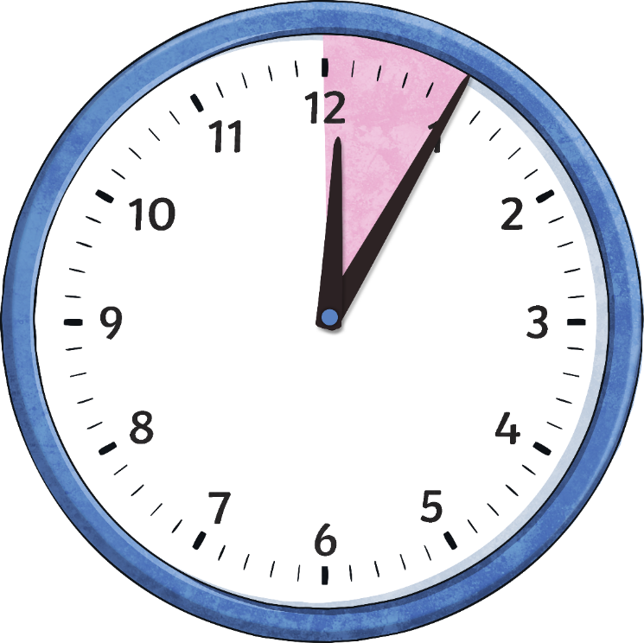
When the big hand points to 1, it means…
5
minutes
past
Click to reveal answer

Slide 4
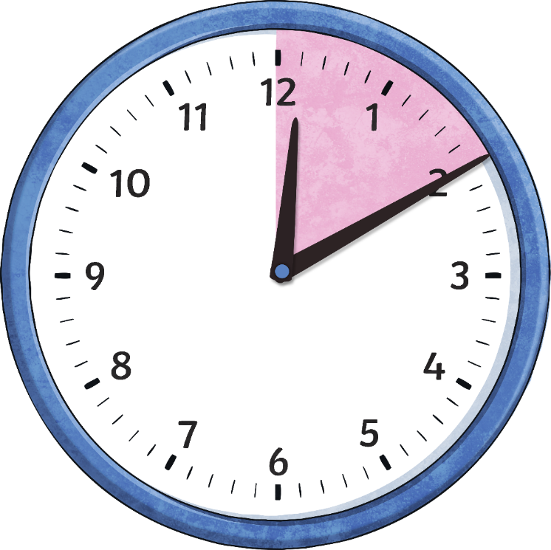
When the big hand points to 2, it means…
10
minutes
past
Click to reveal answer

Slide 5
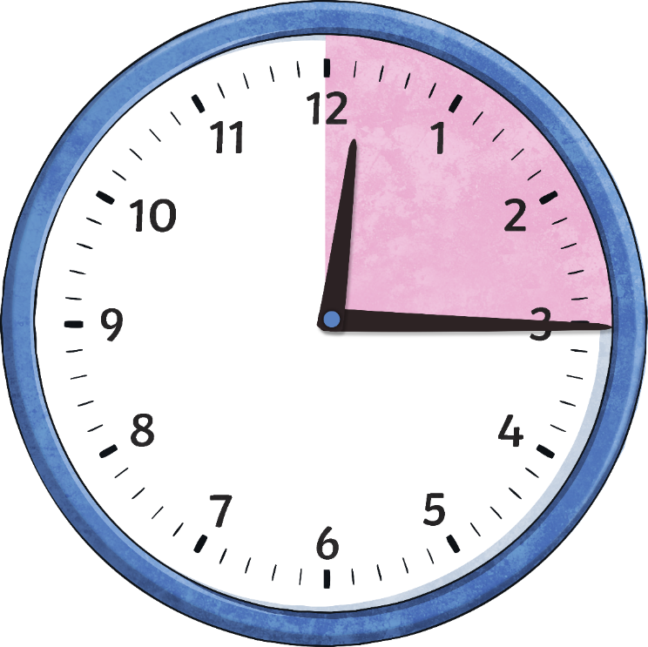
When the big hand points to 3, it means…
15
minutes
past
Click to reveal answer

Slide 6
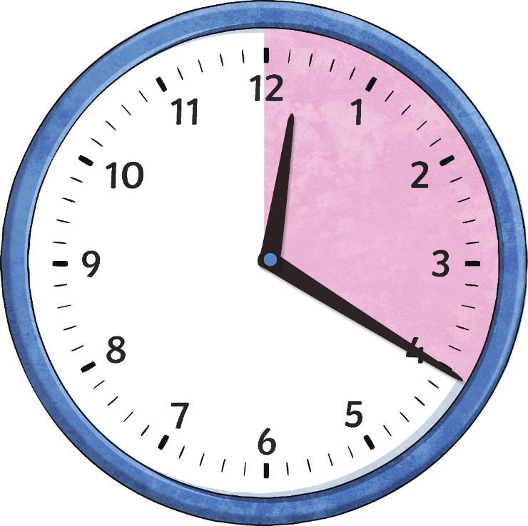
When the big hand points to 4, it means…
20
minutes
past
Click to reveal answer

Slide 7
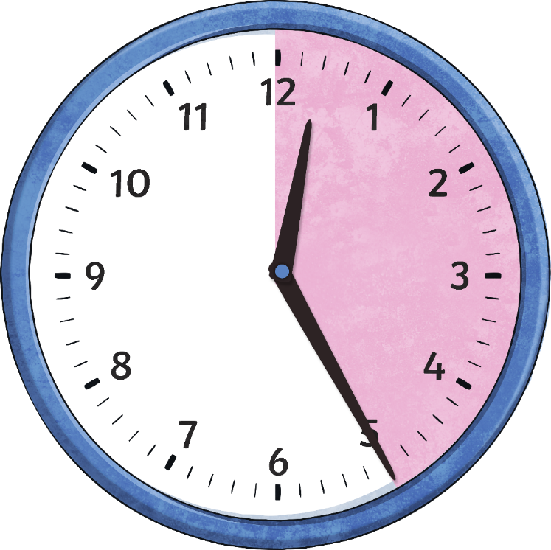
When the big hand points to 5, it means…
25
minutes
past
Click to reveal answer

Slide 8
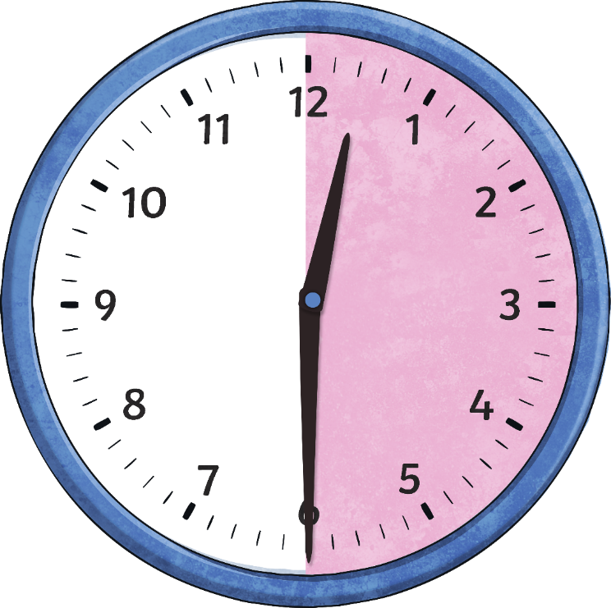
When the big hand points to 6, it means…
30
minutes
past
Click to reveal answer

Slide 9
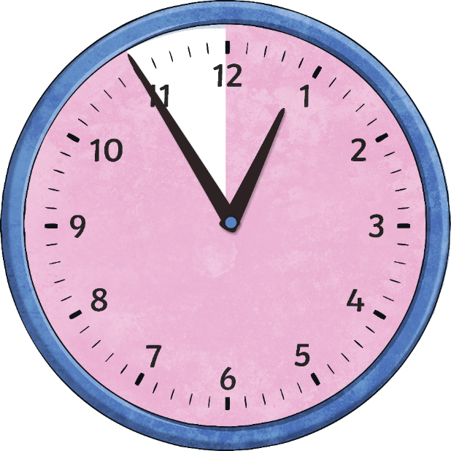
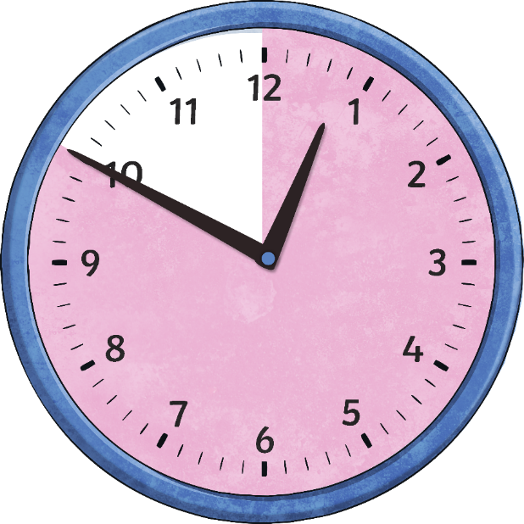
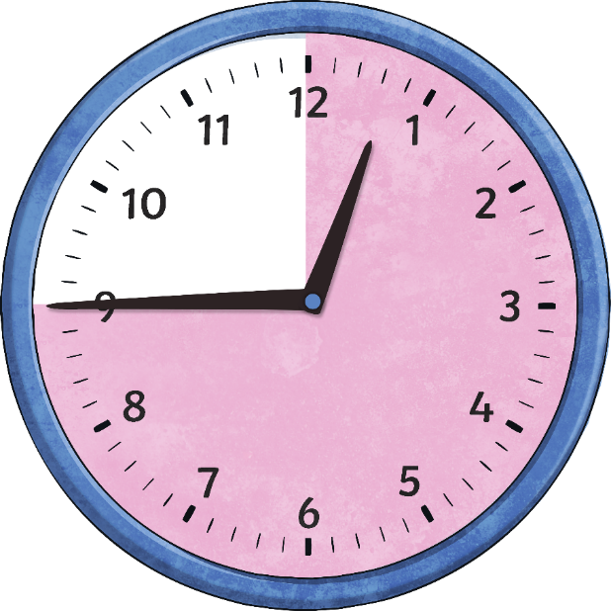
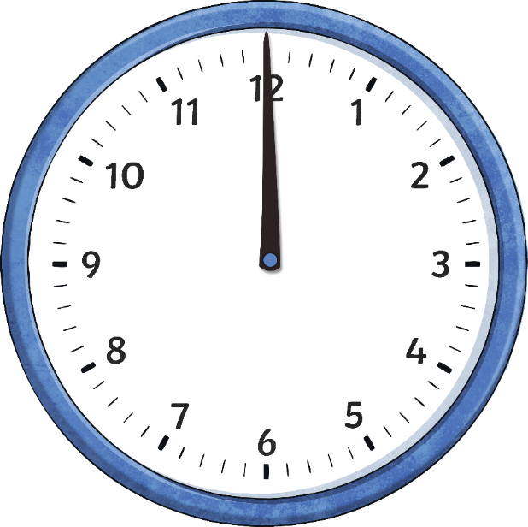
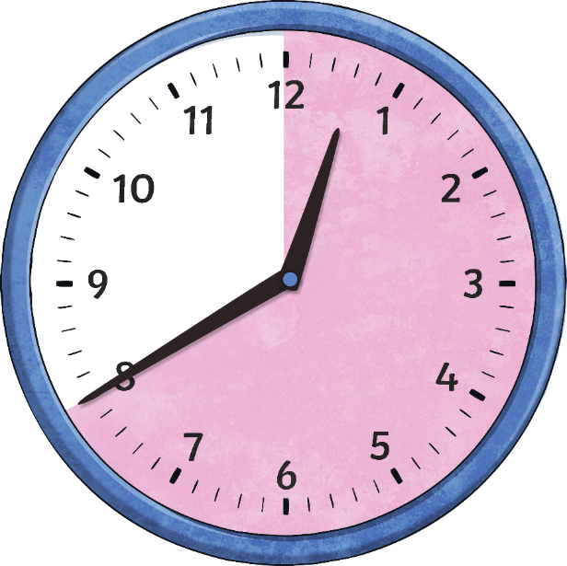
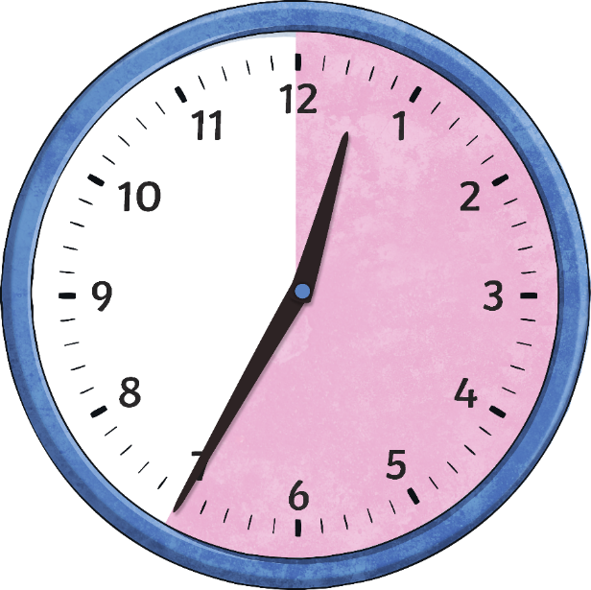
Telling the Time
Now let’s look at the other half of the clock.
We are going to look at the minutes to the next hour.
5
10
15
20
25
minutes
to
minutes
to
minutes
to
minutes
to
minutes
to
o’clock

Slide 10

When the big hand points to 7, it means…
25
minutes
to
Click to reveal answer

Slide 11

When the big hand points to 8, it means…
20
minutes
to
Click to reveal answer

Slide 12

When the big hand points to 9, it means…
15
minutes
to
Click to reveal answer

Slide 13
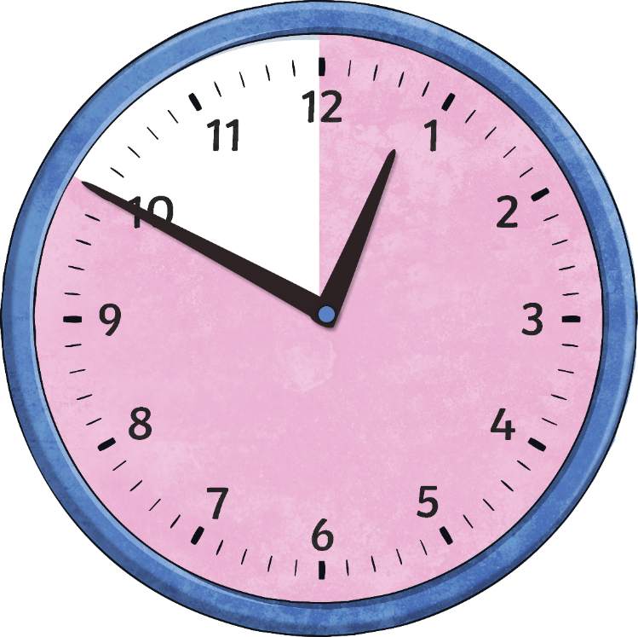
When the big hand points to 10, it means…
10
minutes
to
Click to reveal answer

Slide 14
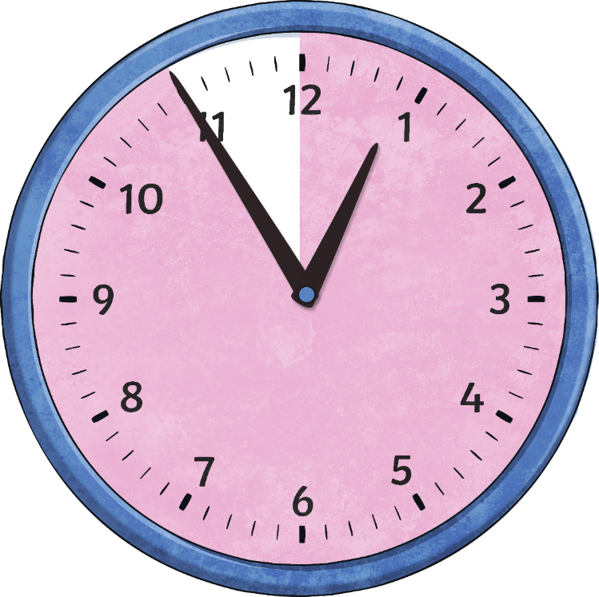
When the big hand points to 11, it means…
5
minutes
to
Click to reveal answer

