Slide 1
Welcome to Year 5
Miss Rose, Mrs Price and Mr James

Slide 2

This morning:
Routines and timetable
Equipment
Expectations and behaviour including Zones of Regulation
Early Bird Groups & Interventions
Church Services
Extra- Curricular Clubs
Website including homework
Supporting learning at home
Breaks and Lunches
How to contact us if needed
Any questions?

Slide 3
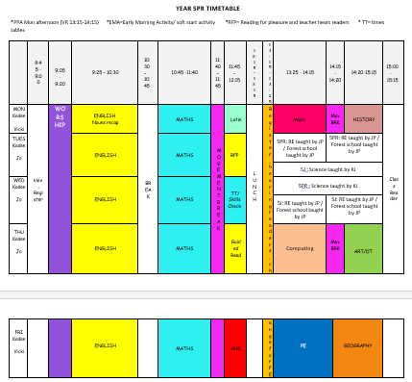
Routines
The children will enter through the red gate and walk through the KS1 and KS2 playground and enter the school through the KS2 hall. Children will be greeted by an adult in year 5.

Slide 4

PE and Swimming
PE - We will do P.E. on a Tuesday and Friday afternoon.
Some children will be invited to swimming booster sessions throughout the year. This will be communicated once Mrs Russell has assessed them.
Please sure PE kits are in school fully labelled at the start of a term, these will then go home at the end of the term.
Please make sure that they have appropriate footwear for PE as these are useful for rainy days. Spare socks are useful in PE bags too!
Participation in both swimming and PE lessons is compulsory.

Slide 5
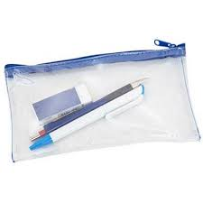
Equipment:
The children are provided with a pencil case and the stationery that they will need in school. Please do not send your child in with any personal pencil cases (or stationery items) from home.
All children will have books given to them to complete their learning in. We will remind children to take home their contact book, reading record book and reading book. These must come in every morning. Children must alert their TA if there is a note in the contact book.

Slide 6
Expectations
We follow our class charters which we have developed together.
To reward good behaviour and work, we use the following: house points, Fermor merits, raffle tickets, star of the day.
If the children make the wrong choice we give a warning in the first instance, the child is offered two choices, if the behaviour persists you will be notified by your child’s teacher. If the behaviour is unsafe or threatening to other children they will not be allowed on the playground.
Appropriate consequences are given when necessary as are opportunities to make the situation right and amend the behaviour.
We expect all children to be smartly dressed in the appropriate uniform. Please see the website for details. Please make sure that all their uniform is labelled.
Children are encouraged to use Zones of Regulation each day to consider how they approach their learning and behaviour in class and to assist them in regulating their feelings.

Slide 7

Groups and Interventions
We will have interventions running for certain groups during the school day within our phase. Some children are offered EM sessions or short sessions after school.
Homework club will be 15 minutes at the end of the school day in 6N. It is an optional club so the children can choose each week if they’d like to attend.

Slide 8

Church Services and other important dates
During the year our year group will lead two of the whole school church services. Parents and carers of children in Year 5 are invited to join us for these services so please keep the dates free!
Friday 25th September – Inset Day
Tuesday20th October and Thursday 22nd October – Parents' Evenings
Wednesday 25th November – Year group church service.
Tuesday 5th January – Viking Day (Payment on ParentPay)
Friday 25th March – Easter Service
Thursday 17th June – Battle Abbey Trip (Payment on ParentPay)

Slide 9

Extra-Curricular Activities
There will be opportunities for your child to join clubs.
Currently, First Class run a few different before and after school clubs. Please enquire at the school office if you are interested. There is also Eezi blocks and various Music clubs.
KS2 running club will start soon. Signed forms must be returned to participate so please let Miss Newman know if your child would like to sign up.
In addition, there will be various drop-in clubs during lunchtimes run by teachers. The children will be advised when these are starting in due course.

Slide 10
Website including Homework
Please frequently keep an eye on:
The Year 5 Year group page.
The Year 5 class page.
The curriculum page.
Class pages will be updated with snapshots, home learning and spellings.
Homework will be put on the homework section on a Friday to be handed in by the following Thursday.
Spellings will be set on a Friday and the children will write these in their contact books on Monday morning. A spelling quiz will be given on Friday mornings each week.

Slide 11
Supporting Learning at Home
There are many ways that you can support your child with their learning at home. Including:
Reading Daily – Both to themselves and to another person
Times tables practise – 5 minutes a day
Completing homework tasks
Encouraging learning to be applied in real life eg writing a shopping list, helping calculate total shopping bills, doing chores to encourage taking responsibility etc.

Slide 12
Breaks and Lunches
Children are allowed to bring a healthy snack for break. This can be either a piece of fresh fruit or some vegetables (eg: carrot sticks or cucumber).
Please remember that we are a nut free school.
If you wish to book school lunch for your child please do so via Parent Pay. Children are not allowed to change the choice that has been booked for them.

Slide 13
Can you help us?
During the year there are various opportunities where we would really appreciate your help.
If you feel you may be able to volunteer to help us in any of the following ways please leave your name and contact details on the sheet before you leave. This is not a definite commitment to help at this stage:
We are looking for:
People to help with swimming/ Forest School
People to listen to readers
Help with school trips

Slide 14

If you need to get in touch:
If you need to speak to us in person, you may be able to catch up with us before or after school but this is not always a convenient time to talk. If not, you can arrange a meeting via the office.
Please let your child know if you have written a note in their Contact Book. In Year 5, it is their responsibility to show us.
Please use the contact book to inform us of any important changes to pick up arrangements and any other important information regarding your child. Appointments also need to be registered with the office.
The other way that you can contact us is by e-mailing the office. These e-mails will then be sent to us.

Slide 15

Are there any questions?

