Slide 1
Welcome to Year 3
Our team consists of:
Mrs Jeffs
Mrs Miller
Miss Groves
Miss Cashmore
Mrs McLeod & Mrs Piper

Slide 2





Year 3 expectations
Reading
Kits and Uniform
Contact Books
Pencil cases

Slide 3
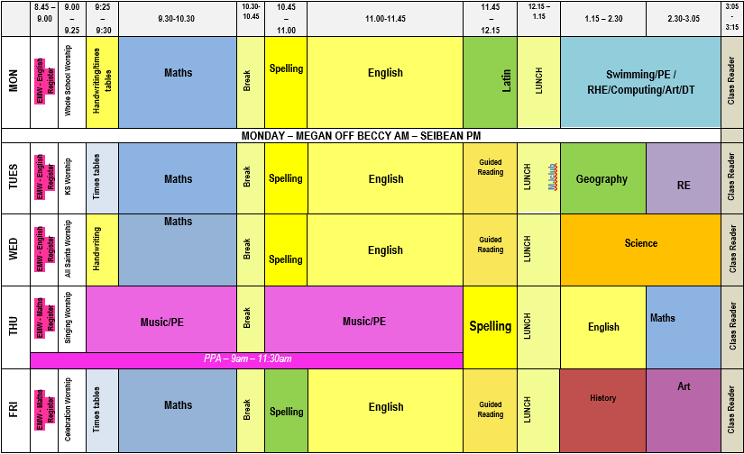
Routines and Timetables

Slide 4
Behaviour
Verbal warning for repeating incidents.
Next stage after verbal warnings
followed up by a 5 minute sanction. Message in contact book if unable to speak to parent/guardian.
House Points
Fermor Merits
Raffle Tickets

Slide 5
Class page, Website and Home Learning
Spellings
Times Tables
Task or project – every two to three weeks.
https://www.fermorschool.org.uk/

Slide 6
Interventions
Sessions after school – if your child is chosen a letter and agreement needed from adult. (Not until after half term.)
Sessions throughout the day – no agreement needed, but we may talk to you about what your child is a part of.

Slide 7
Any questions…
Thank you so much for coming ☺
Please make sure you have signed on the sign in sheet for your child’s class.

